Slide 1

Inspark
Tingcong Jiang, Chenyu Cao, Shijie Xu, Yiran Tan, Zhuohuan Li, Buyuan Lin, Samuel Cho, Christopher Cheng

Slide 2
Problem Statement
Lack of garage management
Wasting time finding parking spot
Inconvenient payment
Having no preview of parking status
Drivers with special needs have problems with parking

Slide 3
Solution
Easy-to-use backend managing software
Online parking spots reservation
Automatic payment methods
One-click parking status checking
Smart guiding system

Slide 4
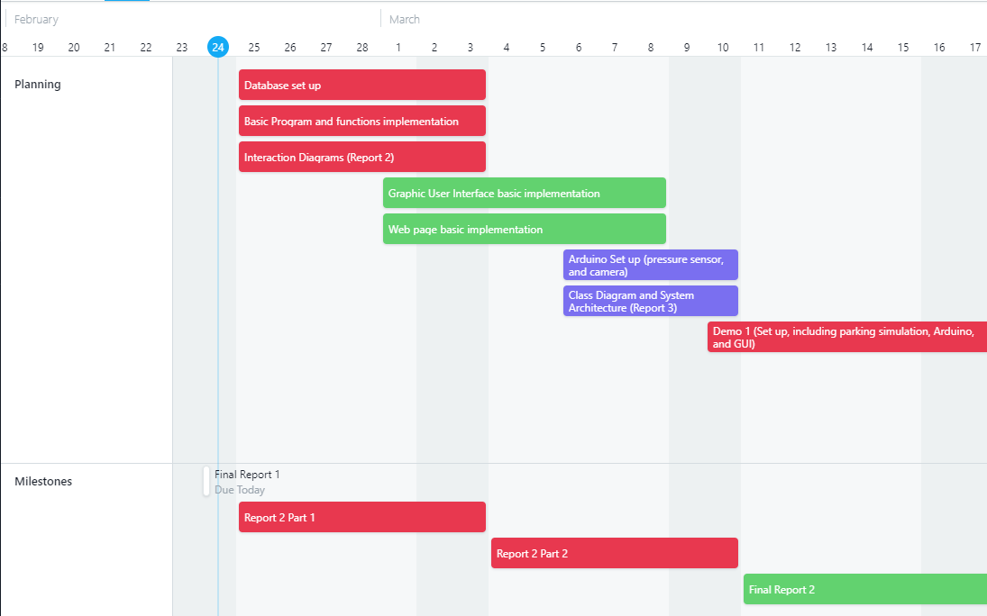
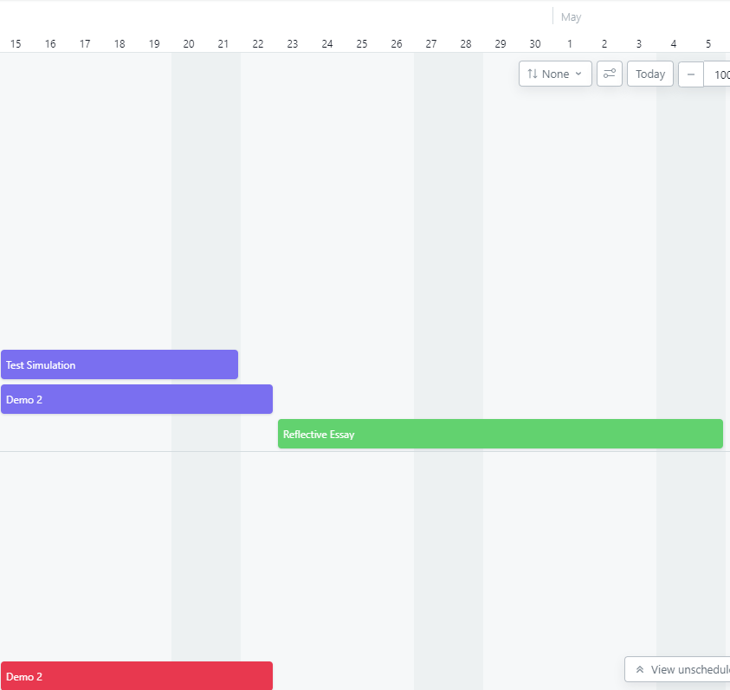

Roadmap

Slide 5
Demo
Pressure triggered camera (based on Arduino)
Online garage map
Backend managing software (based on Java)

